Slide 1
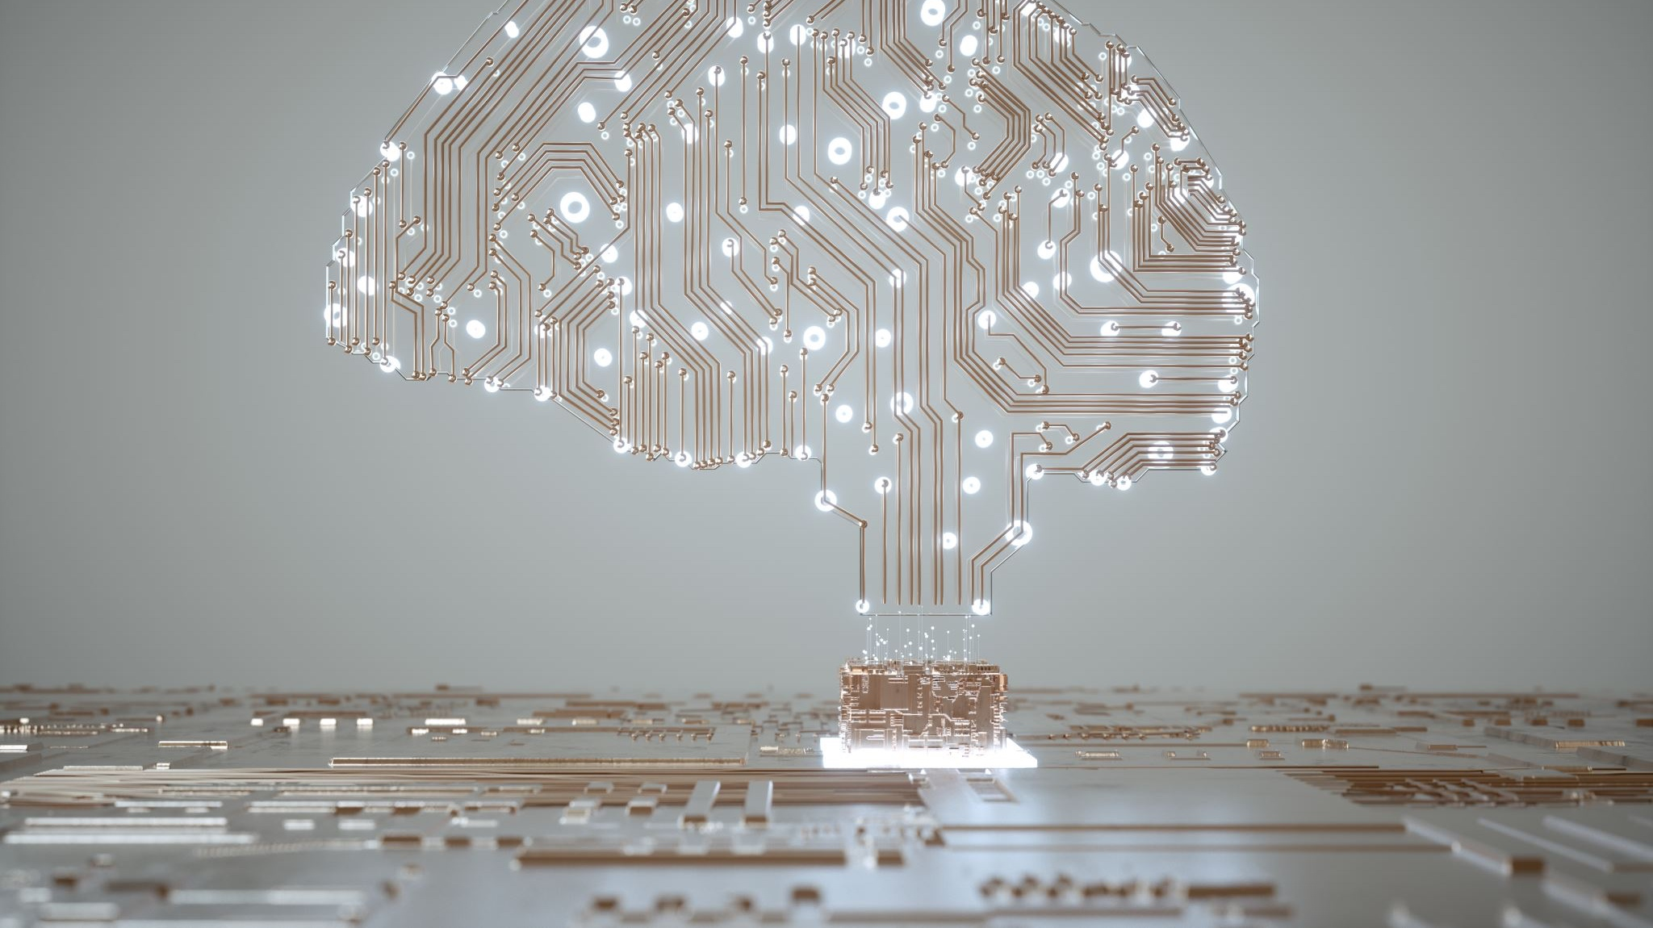
Artificial Intelligence (AI)
Year 5 - 6

Slide 2
AI Ethics
Where do we trust AI?
If a self-driving car has a crash, who is responsible?
Should we let AI decide who gets a job?

Slide 3
Societal Implications
If an AI makes a song or picture, who do you think owns it: the person who trained it, the AI, or both?
What steps can we take to prevent people from creating AI images and videos of us?

Slide 4

Training our own AI Model
On Machine Learning for Kids (ML4K), you are going to use images to train an AI model to identify and label an image between at least three categories (eg: between dogs, hamsters, rats or cats, rock, paper or scissors)
https://machinelearningforkids.co.uk/#!/login

Slide 5
Testing
Test your model with some of the items you trained it with, as well as some other random things, and observe the results
Where did it succeed and fail?
Why is the data we use to train the model important? What happens if we use bad or inaccurate data?

Slide 6
AI Game
Using the AI you created previously on Teachable Machine or a pre-built AI on ML4K, create a program in Scratch using this AI.

